Slide 1

QuikPik: The Humble Beginning
Created by:
Brandon Chan
Carson Mummert
Eric Kohler
Joel Alfveby
Nathan Limmer

Slide 2

Problem Introduction
You and your friends are deciding to watch a TV series together because we are all stuck at home because quarantine and want something fun to do together. It takes forever to have everyone agree on what to watch because everytime a new idea is brought up it takes time to describe what it is and go through the whole process. But what if there was a quicker way.
QuikPik is an app that helps streamline that issue by having the users all vote on choices like restaurants, TV shows, movies, etc. and then picking the best solution for the group
Notes:
This should be one minute
Imagine you are with a group of friends and you all want to go out to eat. One friend doesn’t care, another is really excited about one place, and another friend doesn’t like that food, but won’t essay something to prevent any issues. How familiar is this problem?
QuikPik is an app that helps streamline that issue by having the users all vote on choices like restaurants, TV shows, movies, etc. and then picking the best solution for the group

Slide 3

Formative Research: Problem Statement and Semi-Structured Interviews
We, first, formalized the problem statement, as shown on previous slide
Developed a User Research Protocol to interview subjects in an ethical and productive manner
Semi-structured interviews:
Background information re: media consumption
Current media consumption habits
Decision making as a group
Google questionnaire/survey
Notes:
This should be 3 minutes

Slide 4
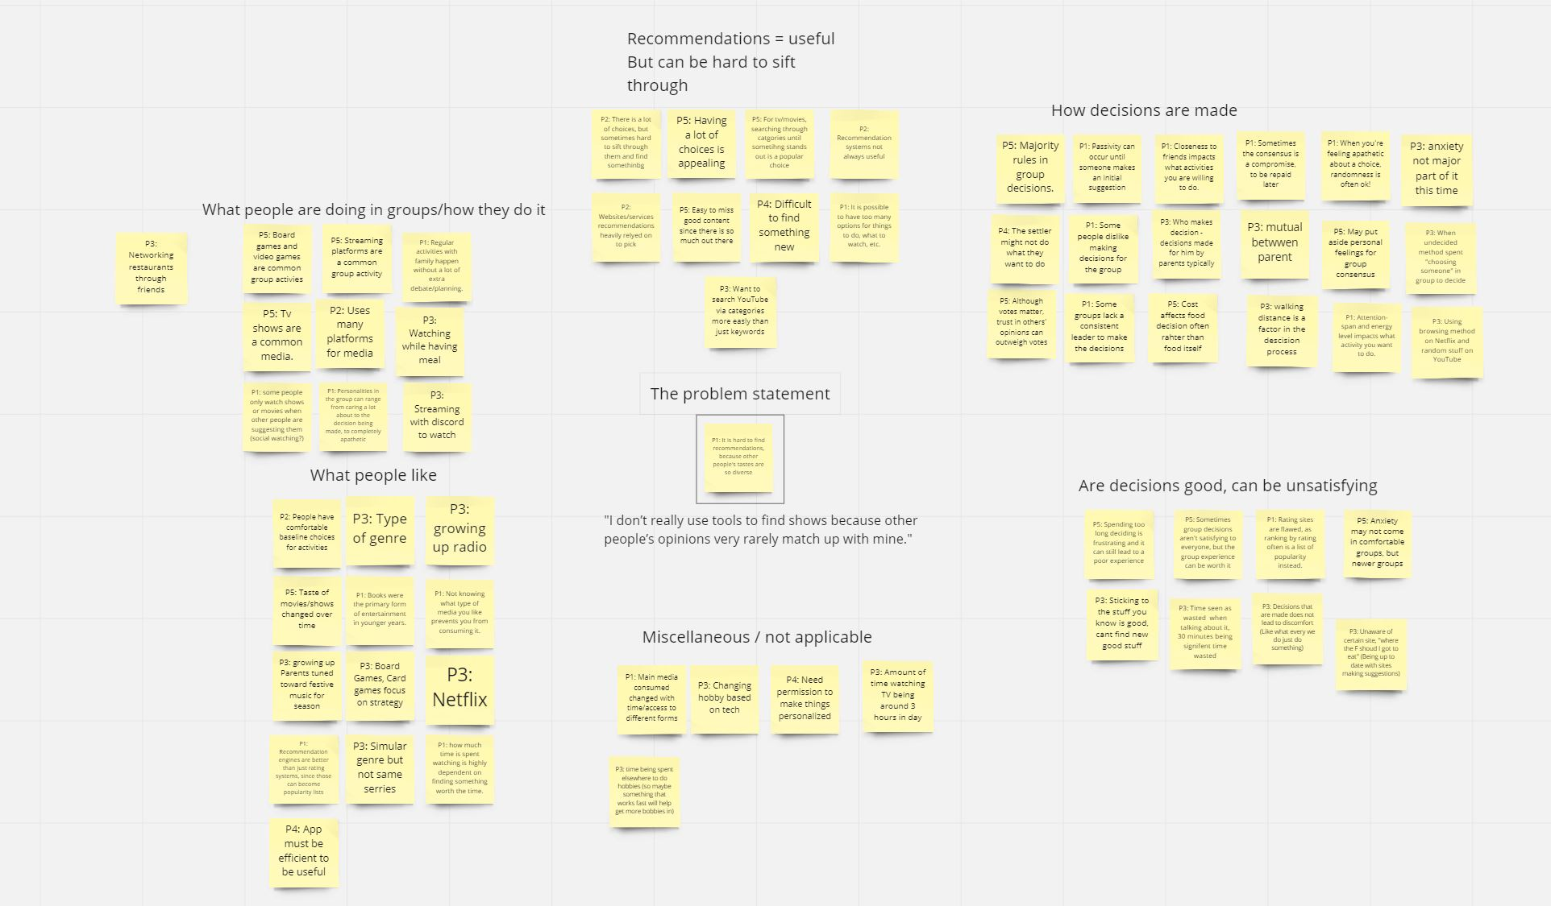
Qualitative Analysis
Qualitative analysis carried out on interview transcripts
Open-coding: selecting important information from transcripts, writing a short phrase explaining what is valuable about the quotation
Clustering Open Codes into rough categories (see image)
Clustering led to common behaviour patterns, which informed the most essential features to include

Slide 5
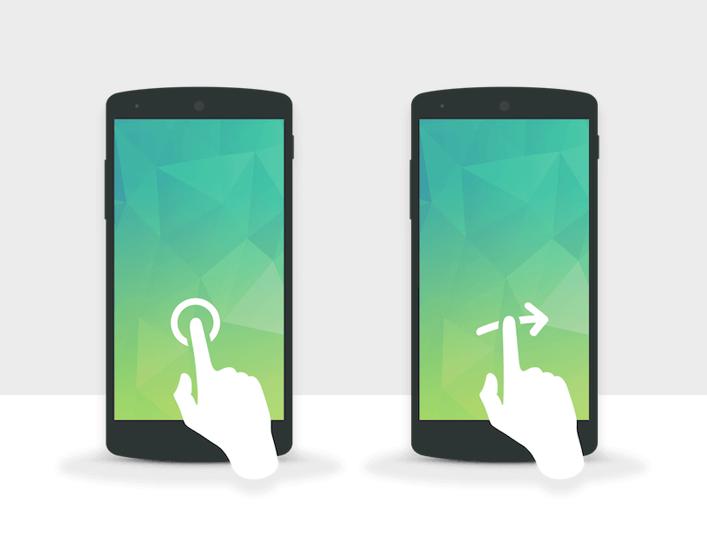
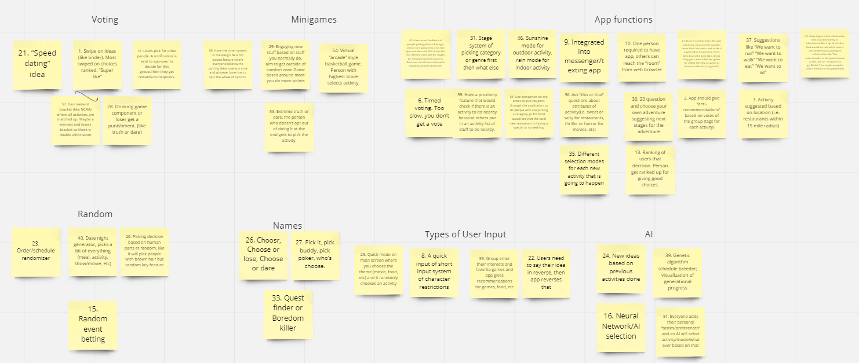
Ideation and Final Idea
Jurassic Park
Directed by
Steven Spielberg
Ideation: generate a large list (75 items) of different ways to solve our problem statement
Clustering of Ideas: 5 Categories organically arose:
Voting, Minigames, AI, Random Selection, and Core app functions
Several rounds of selection and rating of the ideas pared down the list of possible ideas
Aspects most essential to a well-designed and usable application remained, giving final app idea

Slide 6
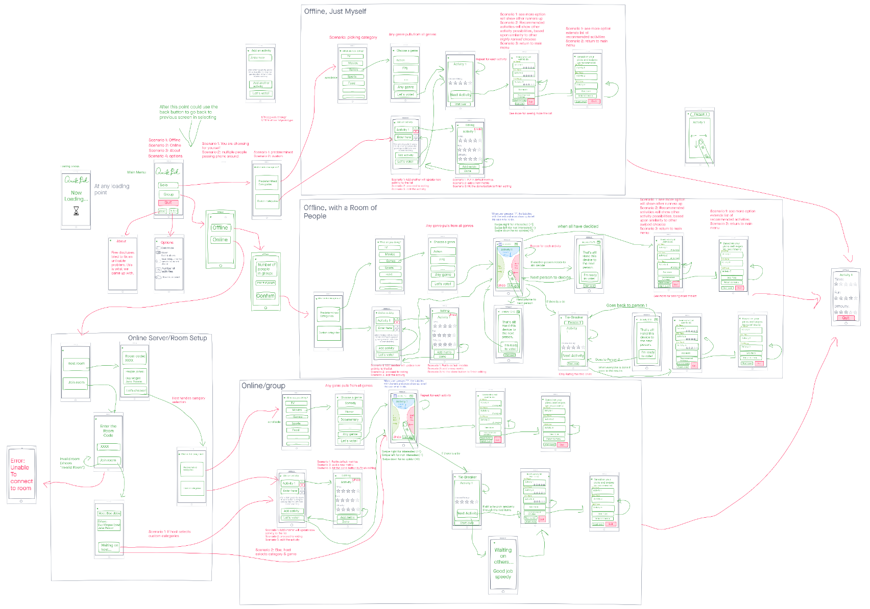
Low-Fidelity
Prototype
Cognitive Walkthroughs and Heuristic Evaluations helped us refine our solution and led to our final low fidelity prototype
3 main tracks, depending on group size/app availability

Slide 7
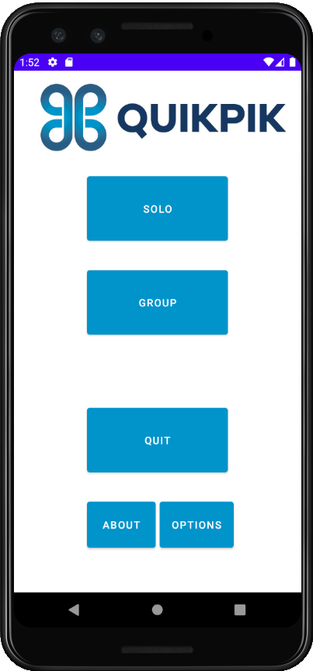
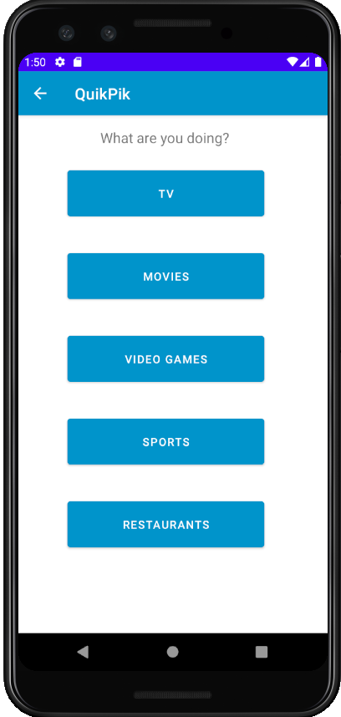
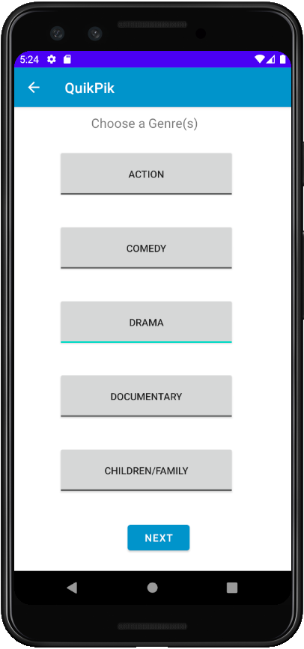
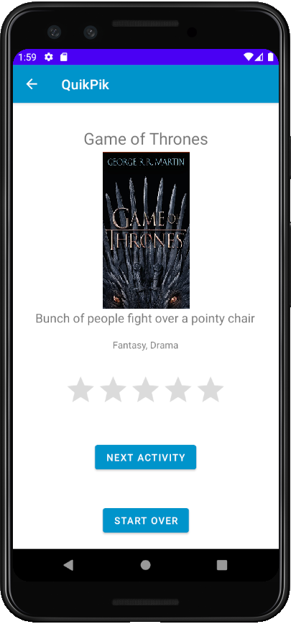
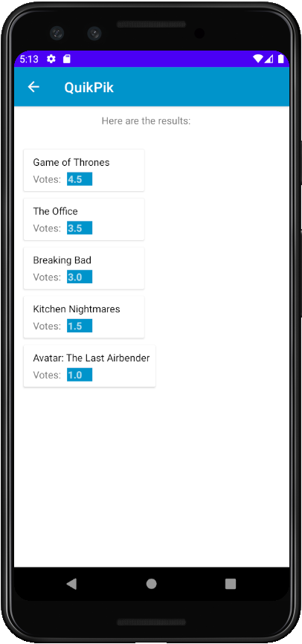
Final App
Solo-Selection Track:
Notes:
This should be 2 minutes
Images: Front page, category type, Predetermined cat, genres, choosing example, results example, custom example (1 slide/image, each taking ~10 seconds)
Or
Video: navigate through like above, mouse should be slow and consistent (60-90 sec)

Slide 8
User Testing: Methods
Method 1: User uses QuikPik to find a TV show to watch
Formative - reveal usability errors, get user’s impressions of the errors
Summative - time to find a show to watch, times user presses back button
Method 2: User uses Netflix to find a TV show to watch and compares it to QuikPik
Summative - number of users that prefer QuikPik or Netflix
Notes:
This should be 4 minutes - T-test, Formative vs. Summative

Slide 9
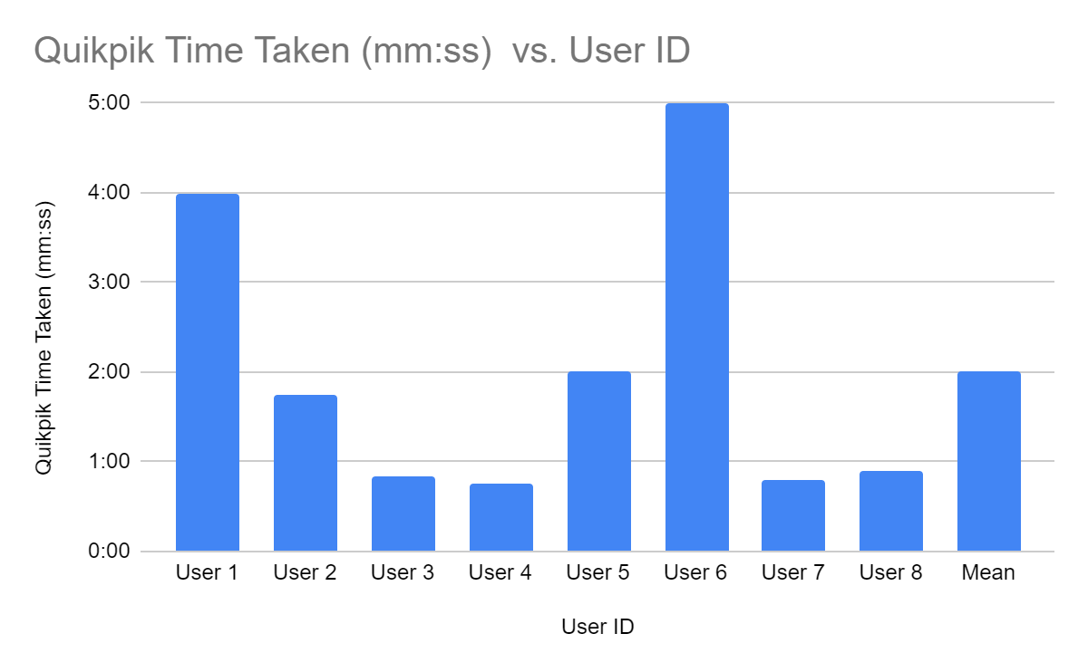
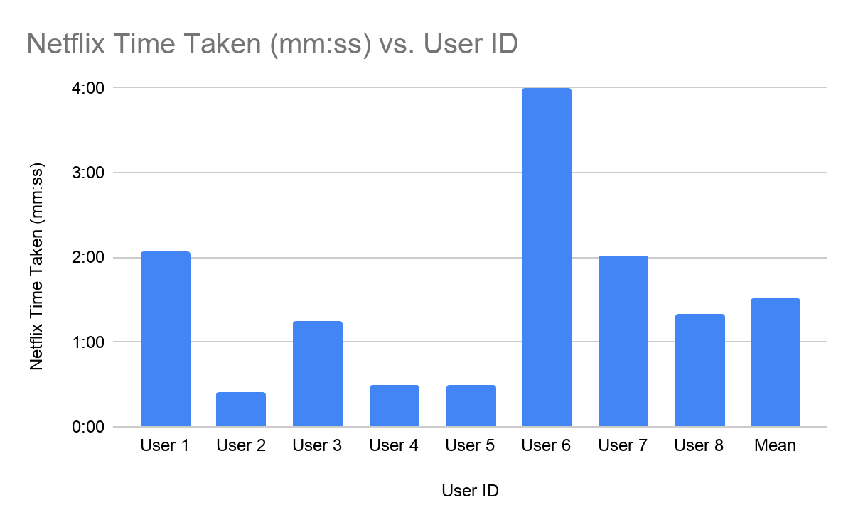
Statistical Analysis
Problem Statement: Does QuikPik speed up activity selection time vs. Netflix?
Average time for Netflix was 30 seconds faster than QuikPik (120 seconds vs 90 seconds).
Sample Standard Deviation: s_{QuikPik}= 91.41 seconds, s_{Netflix}= 67.42 second
Can use a hypothesis test of two means

Slide 10
Statistical Analysis, cont
Hypothesis test of two means tests our claim that QuikPik speeds up activity selection.
H₀: u_{QuikPik} - u_{Netflix}= 0, H_{A}: u_{QuikPik} - u_{Netflix}< 0, n = 8
Test Statistic: ((120-90) - 0) / √[ (67.42² / 8) + (91.41² / 8) ] = .747
p = .234
There isn’t strong evidence that QuikPik is faster than Netflix.
Errors with Test / Confounding Conditions:
Familiarity with Netflix and/or unfamiliarity with QuikPik
Small sample size, high sample variance (s = √[σ_{QuikPik}²/ n_{QuikPik} + σ_{Netflix} ²/ n_{Netflix}])
Selecting a show that they are familiar with on Netflix, rather than something new which is the primary purpose of QuikPik
Users often times try multiple shows on Netflix before final selection

Slide 11
User Testing: Findings
App specific problems:
App is unclear on what predetermined and custom categories are
The rating screens had no images
Users needed to have the results and ratings explained to them
Users would like some randomness with predetermined categories
Show what platforms the activity is available on
Overall findings:
Users weren’t faster at selecting TV shows from QuikPik vs Netflix
Focus should primarily be on having this app be for groups
Notes:
This should be 4 minutes - T-test, Formative vs. Summative

Slide 12
Future Developments and Testing
Developments:
Create a system that selects from a database (Netflix, IMDB, etc) for predetermined categories.
Finish and expand group selection.
Add more detail to the rating system (more metrics, better explanations of ratings).
Add functionality to select which platforms you want to use (Hulu, Amazon, etc).
Testing:
Increase sample size.
Give a small QuikPik training session prior to timing
Ask participants to find a NEW activity specifically.

